Slide 1
Full Stack Development
Presented By
Prithviraj Patil

Slide 2
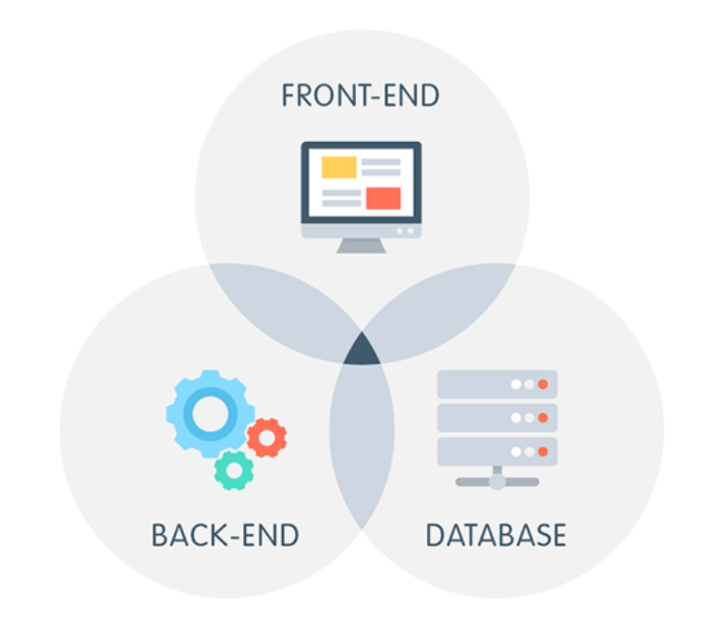
Full stack web development.
Full stack web development is the process of designing, developing, testing, and deploying a complete web application from start to finish. It involves working with both the front-end and back-end of a web application

Slide 3
What are the possible outcomes/applications of MERN Full Stsck?
The MERN stack is a popular choice for developing web applications because it is:
Scalable
Extensible
Some of the possible outcomes/applications of the MERN stack include:
Social media applications
Ecommerce applications
Web games

Slide 4
Technologies available in Full Stack
Front end technologies –
HTML
CSS JavaScript
React js
Back end technologies –
Java
PHP
Python
Node.js
Database –
MySQL
MongoDB

Slide 5
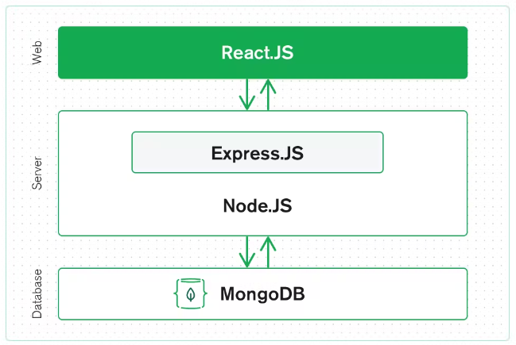
Technologies in MERN Full Stack
MongoDB — document database
Express(.js) — Node.js web framework
React(.js) — a client-side JavaScript framework
Node(.js) — the premier JavaScript web server

Slide 6
As far we have started with the front end of the web applications and till now we have completed
HTML
HTML – 5
CSS – Basics
The technologies we need to learn for our course are Java Script, React(.js), MongoDB, Express(.js), node(.js).
I am preparing by starting a strong foundation in web development fundamentals like HTML, CSS.
Build a portfolio website to showcase my projects and skills.

Slide 8
Thank You

